Slide 1






Metrics to evaluate ML models
Understanding how to measure the performance of ML models
ANKIT MIRAJKAR

Slide 2
AGENDA
Why model evaluation is needed
Regression evaluation metrics
Classification evaluation metrics
Practical examples
How to choose the right metric

Slide 3

WHAT IS MODEL EVALUATION?
Model Evaluation is the process of measuring how well a machine learning model performs on unseen data using quantitative metrics.
It helps determine:
how accurate the predictions are
whether the model learned patterns correctly
whether the model is ready for real-world use
In simple terms:
Model Evaluation = Checking how good our model is.
When we build a machine learning model, it produces predictions.
But we must answer:
Are the predictions correct?
How big are the errors?
Can the model work on new data?
Evaluation metrics help us quantify the performance of the model by comparing predicted results with actual values. Without evaluation, deploying ML models would be guesswork.

Slide 4
REAL-LIFE EXAMPLE
Suppose we build a model to predict house prices.
Actual price:
₹90,00,000
Model prediction:
₹88,00,000
Error:
₹2,00,000
If we test the model on many houses, evaluation metrics calculate:
average error
prediction accuracy
reliability of the model

Slide 5
WHY EVALUATION IS IMPORTANT
1. Measure Model Performance
Evaluation metrics tell us how well the model predicts outcomes.
Example:
Spam detection model
Accuracy = 92%
Meaning:
92% emails classified correctly.
2. Compare Different Models
Often multiple models are built.
Example:
Clearly: Model B performs better.
3. Improve Models
Evaluation helps identify weaknesses in models so they can be improved.
Dataset | Accuracy
Training Data | 98%
Testing Data | 60%

Slide 6
TYPES OF EVALUATION METRICS
Evaluation metrics depend on the type of machine learning problem.
Problem Type | Output Type | Metrics
Regression | Numerical value | MAE, MSE, RMSE, R²
Classification | Category | Accuracy, Precision, Recall, F1
Regression metrics evaluate numerical predictions, while classification metrics evaluate categorical predictions.

Slide 7
REGRESSION METRICS
Regression models predict continuous values.
Examples:
house price prediction
sales forecasting
temperature prediction
stock price prediction
Regression metrics measure how far predictions are from actual values.

Slide 8
Mean Absolute Error (MAE)
MAE measures the average absolute difference between predicted and actual values.
Formula:
MAE = Average(|Actual − Predicted|)
Actual | Predicted
100 | 90
200 | 210
300 | 295
Errors:
10 10 5
MAE:
(10 + 10 + 5) / 3 = 8.33
Meaning:
On average, the prediction error is 8.33 units.

Slide 9
Mean Squared Error (MSE)
MSE calculates the average of squared errors.
Formula:
MSE = Average((Actual − Predicted)²)
Why Square Errors?
Because large mistakes are penalized more.
Example:
Error = 10 → 100
Error = 20 → 400
Large errors become much larger.

Slide 10
Root Mean Squared Error (RMSE)
RMSE is the square root of MSE.
Formula:
RMSE = √MSE
RMSE converts error back to the original unit of the data.
Example:
MSE = 100
RMSE = 10
Meaning: Average prediction error ≈ 10 units.

Slide 11
R² Score (Coefficient of Determination)
R² measures how well the model explains the variation in the data.
Range:
Example:
R² = 0.85
Meaning:
The model explains 85% of the variation in the data.
Value | Meaning
1 | Perfect prediction
0 | No predictive power
<0 | Worse than baseline

Slide 12
CLASSIFICATION METRICS
Classification models predict categories.
Examples:
spam vs not spam
fraud vs legitimate
disease vs healthy
churn vs not churn

Slide 13
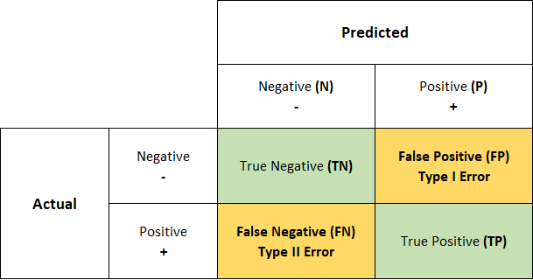
CONFUSION MATRIX
A confusion matrix is a table that is often used to describe the performance of a classification model
(or “classifier”) on a set of test data for which the true values are known.

Slide 14
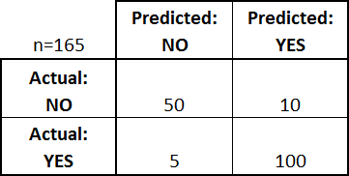
CONFUSION MATRIX
What can we learn from this matrix?
There are two possible predicted classes: "yes" and "no".
If we were predicting the presence of a disease, for example, "yes" would mean they have the disease, and "no" would mean they don't have the disease.
The classifier made a total of 165 predictions (e.g., 165 patients were being tested for the presence of that disease).
Out of those 165 cases, the classifier predicted "yes" 110 times, and "no" 55 times.
In reality, 105 patients in the sample have the disease, and 60 patients do not.

Slide 15
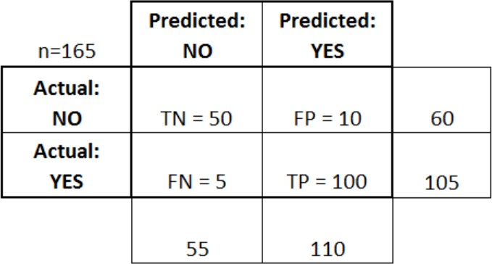
CONFUSION MATRIX
True positives (TP): These are cases in which we predicted yes (they have the disease), and they do have the disease.
True negatives (TN): We predicted no, and they don't have the disease.
False positives (FP): We predicted yes, but they don't have the disease. (Also known as a "Type I error.")
False negatives (FN): We predicted no, but they do have the disease. (Also known as a "Type II error.")
Accuracy: Overall, how often is the classifier correct?
(TP+TN)/total = (100+50)/165 = 0.91
Misclassification Rate: Overall, how often is it wrong?
(FP+FN)/total = (10+5)/165 = 0.09
Precision: When it predicts yes, how often is it correct?
TP/predicted yes = 100/110 = 0.91

Slide 16
SUMMARY

Slide 17
Regression vs Classification Metrics
Regression Metrics | Classification Metrics
MAE | Accuracy
MSE | Precision
RMSE | Recall
R² | F1 Score
Regression evaluates numerical errors, while classification evaluates correctness of predicted classes.

Slide 18
CHOOSING THE RIGHT METRIC
Problem | Best Metric
House price prediction | RMSE / MAE
Spam detection | Precision
Fraud detection | Recall
Imbalanced dataset | F1 Score
Choosing the right metric depends on business impact and risk.

